Slide 1
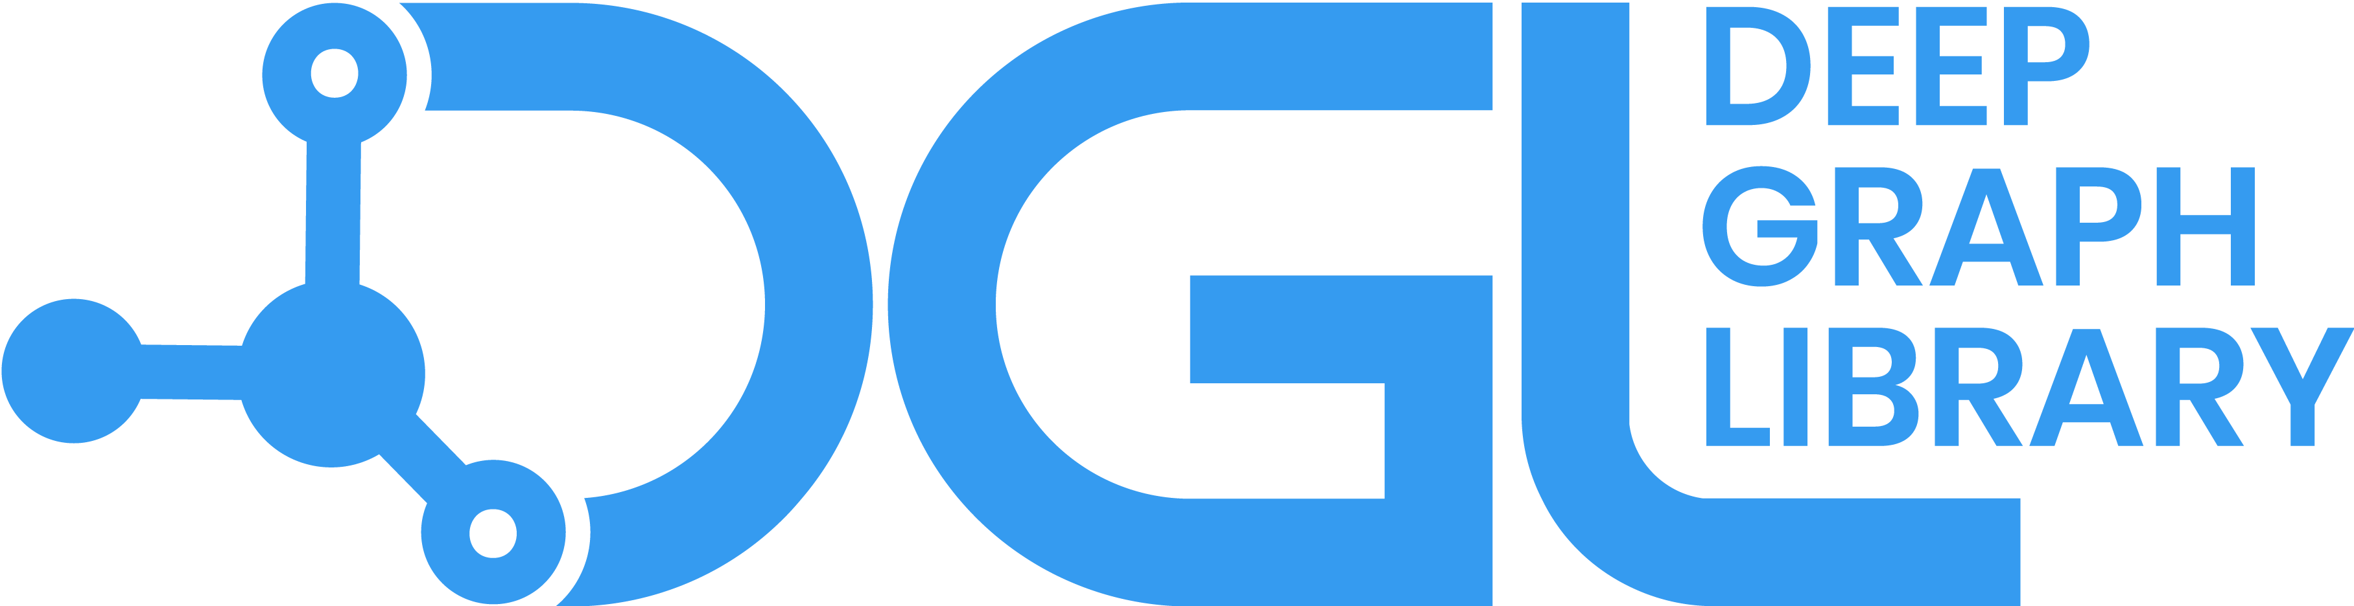

Deep Graph Library an overview
dgl.ai
George Karypis
Senior Principal Scientist, AWS Deep Learning Science, Palo Alto, CA, USA, gkarypis@amazon.com Professor, Department of Computer Science & Engineering, University of Minnesota, Minneapolis, MN, USA, karypis@umn.edu, (on leave)

Slide 2


Task #1: Join DGL’s Slack workspace
Use this QR code to join:
Join the winter school’s channel using this QR code: #jhu-winter-school

Slide 3
GNN Refresher

Slide 4
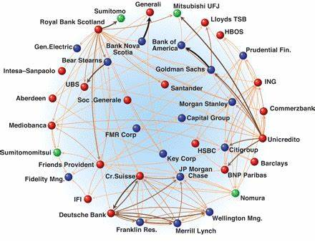
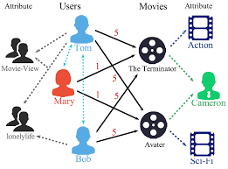
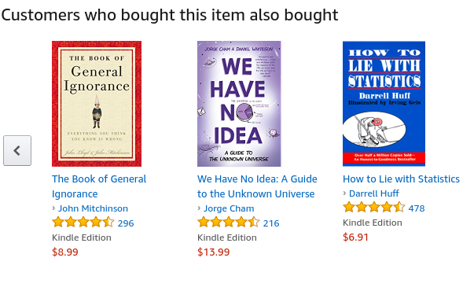
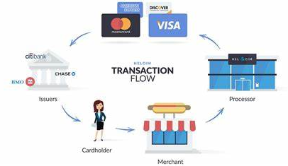
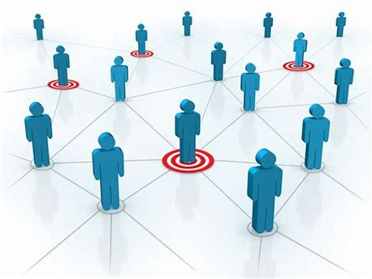
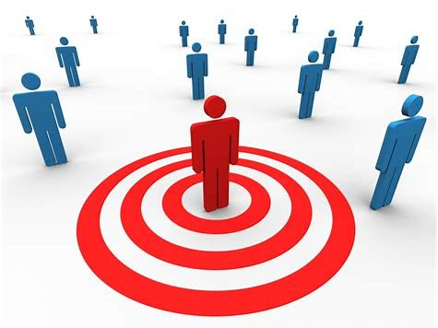
Fraud & Abuse
Recommendations
Detect malicious accounts, fraudulent financial transactions, fake reviews, fraudulent insurance claims, …
Products, media, articles, experiences, jobs, courses, spouses, …
Financial transactions network
Collaborative knowledge graph
Marketing
Who should get a discount? Who are the influencers? Who are the risk of churning?
Social network
Notes:
To motivate the use of graph neural networks, I will like us to consider three applications.
Fraud & abuse
Recommendations
Marketing
[Before showing graphs]
What is common in all these applications is that they use graphs to represent their underling data.
For example, describe each graph.
Now, what is even more interesting is that I can use these graphs to solve the underling problems by using ML approaches based on graph learning!
e.g., find fraudulent financial transactions, decide what to recommend to Tom, and find the most influential people to target

Slide 5
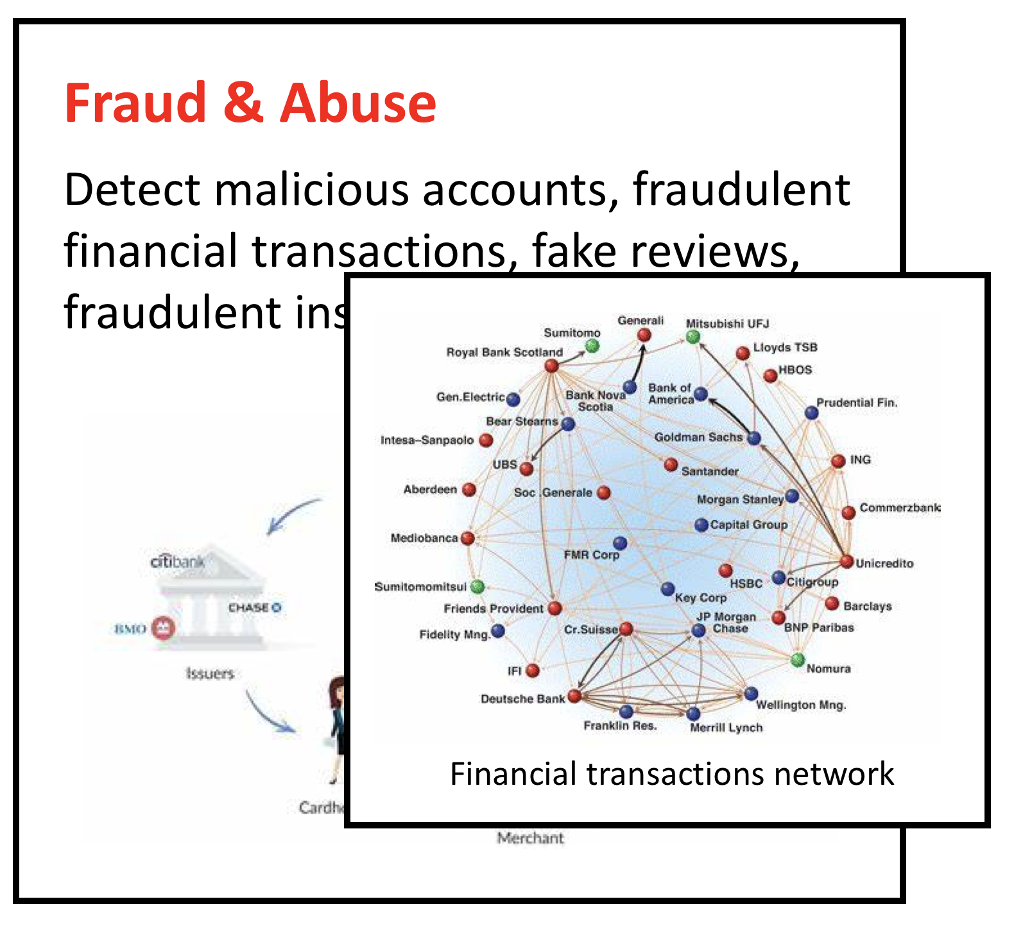
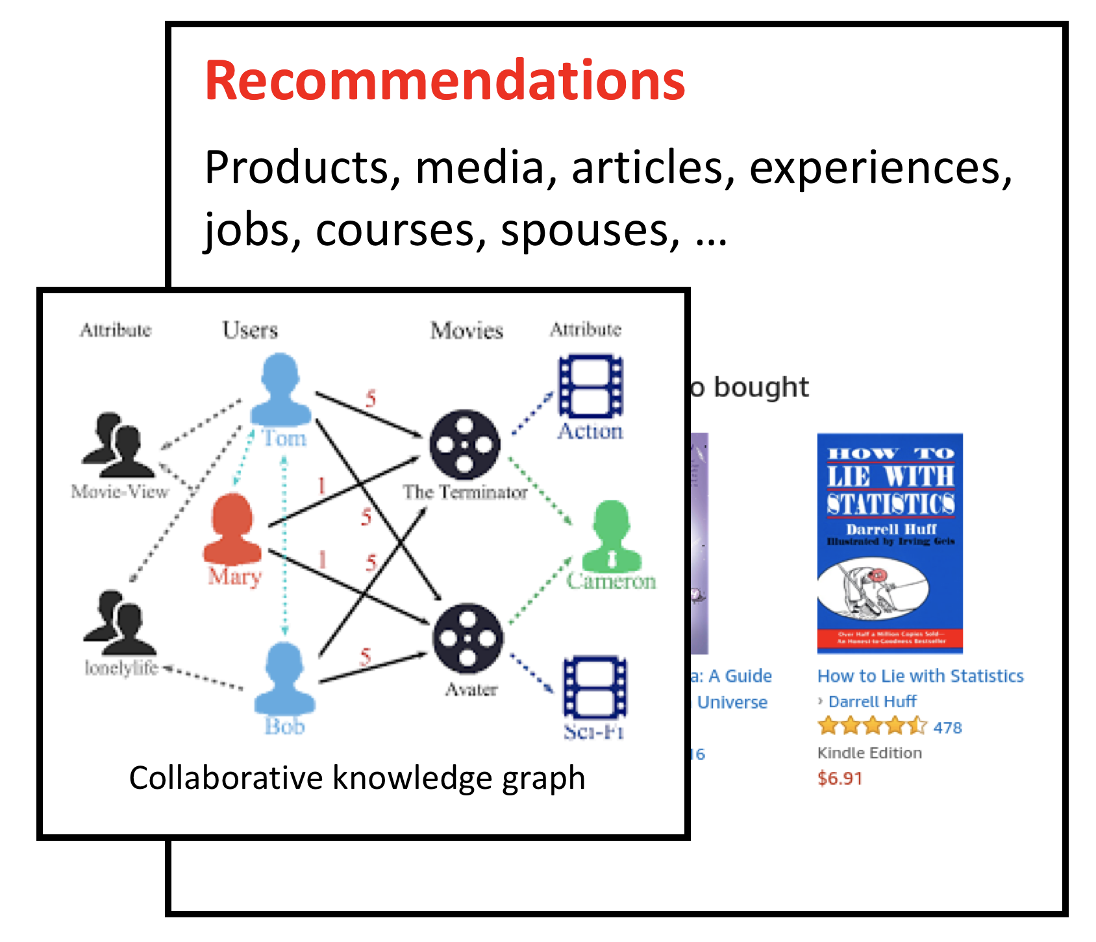
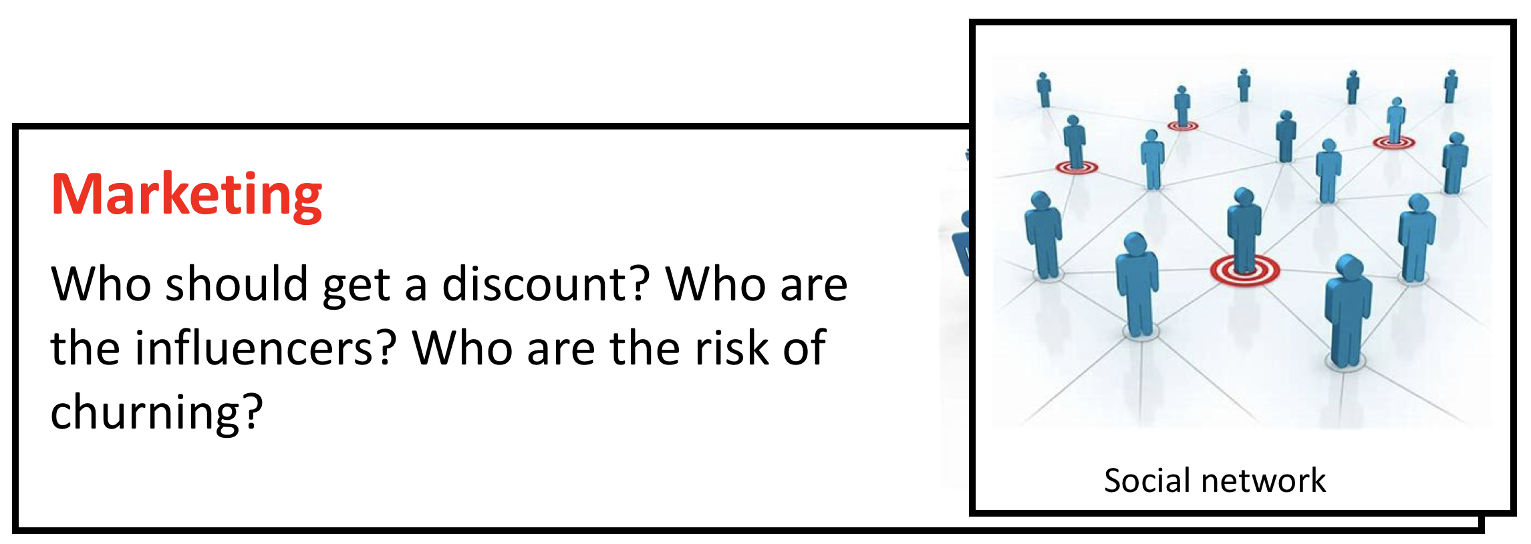
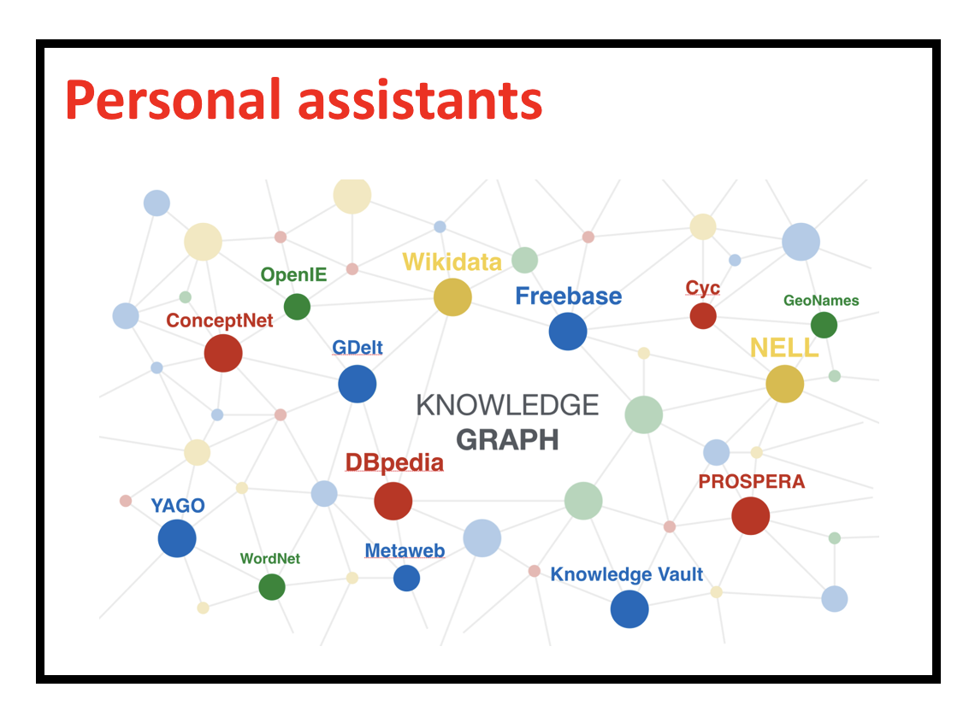
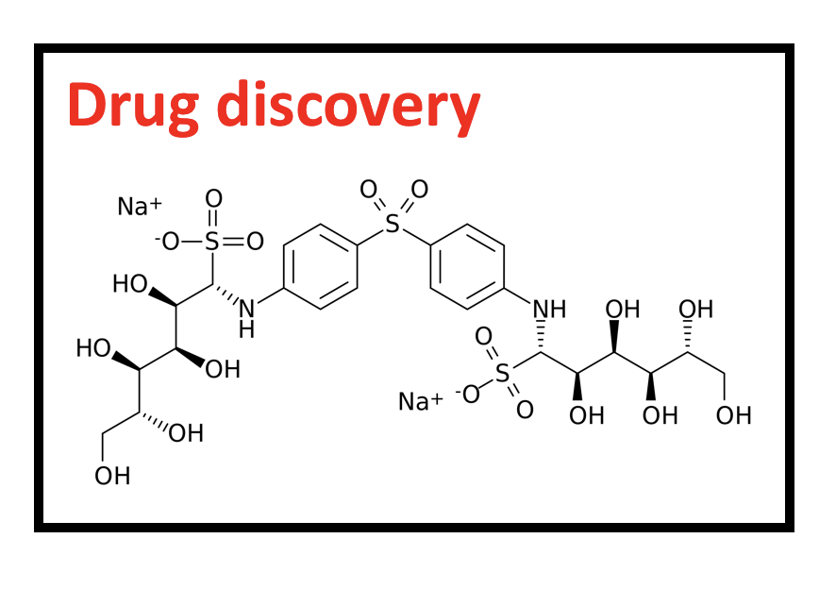
Tasks in graph learning
Node classification
Detect malicious accounts
Target right customers
Link prediction
Recommendations
Predict missing relations in a knowledge graph
Graph classification
Predict the property of a chemical compound

Slide 6
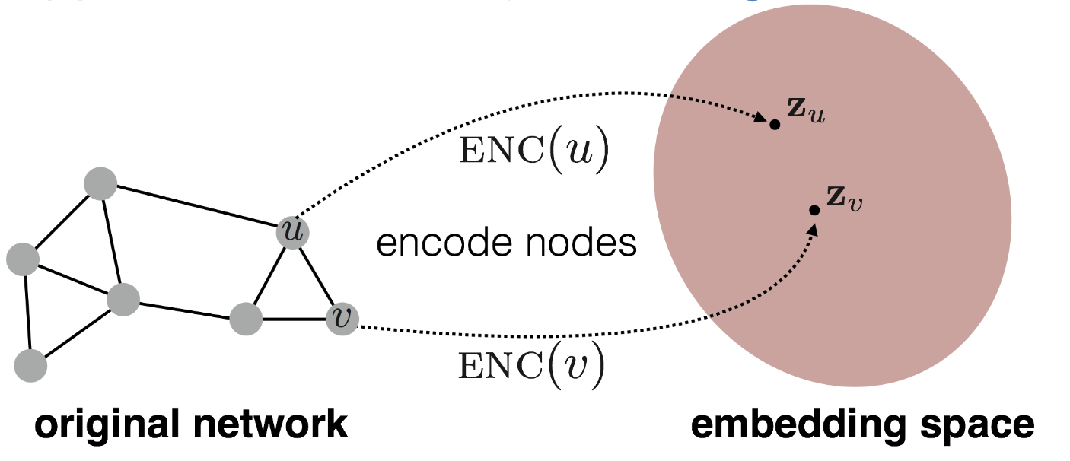
Graph learning and node embeddings
Embed nodes to a low-dimension space so that these embeddings capture the essential task-specific information and use them to train off-the-self classifiers.
For example, node similarities in the embedding space approximates the similarities in the original graph.
Representation Learning on Networks, snap.stanford.edu/proj/embeddings-www, WWW 2018
Notes:
A common way to solve the various graph learning problems is to …

Slide 7
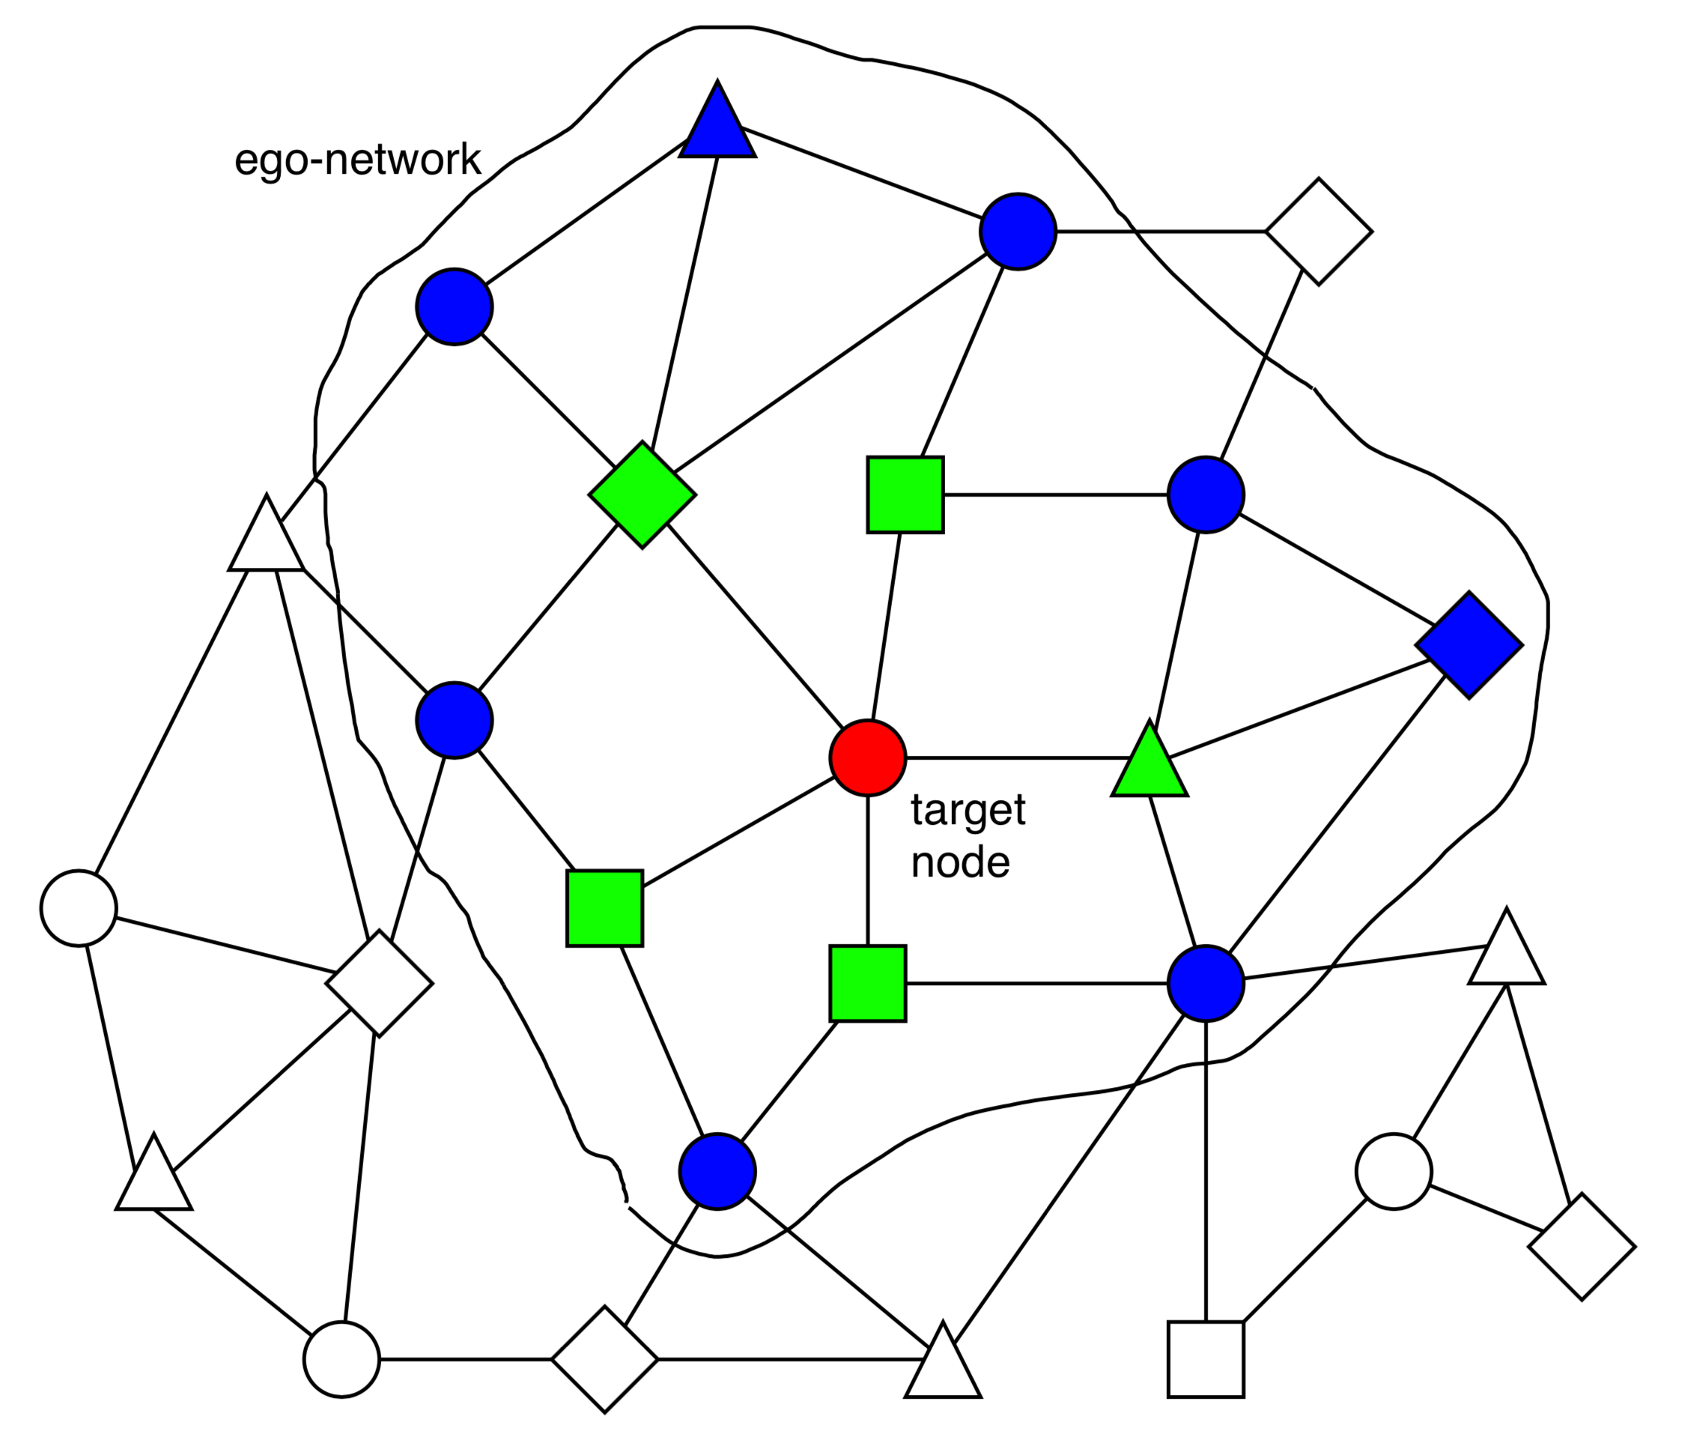
Graph Neural Network (GNN)
A family of (deep) neural networks that learn node, edge, and graph embeddings.
How do GNNs work?
An ego-network around each node is used to learn an embedding that captures task-specific information.
The embeddings use both the structure of the graph and the features of the nodes and edges.
The embeddings are learned in an end-to-end fashion; thus, the predictions are a function of the target node’s ego-network.

Slide 8
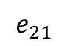
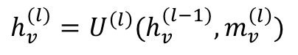
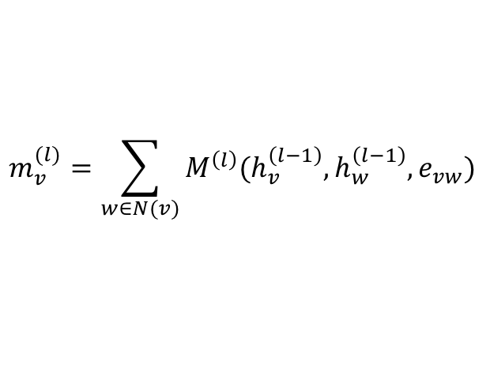
A general graph neural network formalism
Graph neural networks are based on message-passing
Reduce/Aggregate
h₅
Message
h₂
v₅
$$m_{v}^{(l)}=\sum_{w∈N(v)}{M^{\left(l\right)}(h_{v}^{\left(l−1\right)}, h_{w}^{\left(l−1\right)}, e_{vw})}$$
v₂
$$e_{21}$$
v₁
h₁
$$h_{v}^{(l)}=U^{\left(l\right)}(h_{v}^{(l−1)}, m_{v}^{\left(l\right)})$$
Update
v₃
v₄
h₄
h₃
Neural Message Passing for Quantum Chemistry
Notes:
Though there are several prototypical graph neural network formalisms, the most common one is based on the message passing model.
The idea is that nodes send messages to their adjacent nodes, then each node aggregates all the messages that it receives from its incidents nodes and uses those messages to update its representation/embedding.
The set of operations involving message passing, aggregation, and update correspond to a layer of the GNN network.

Slide 9
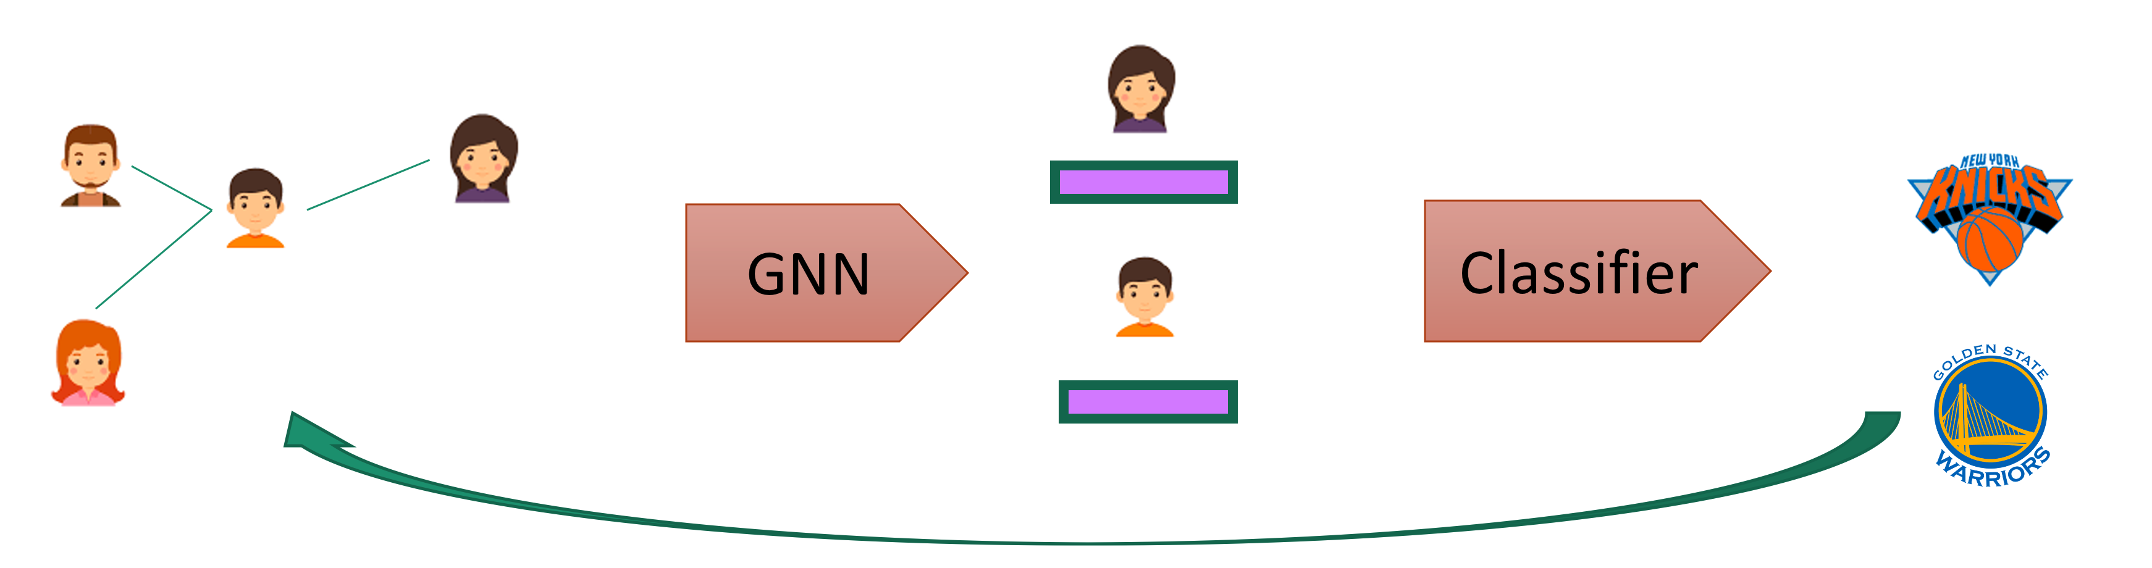
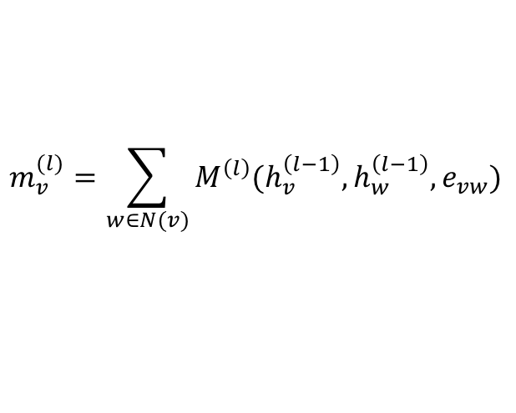
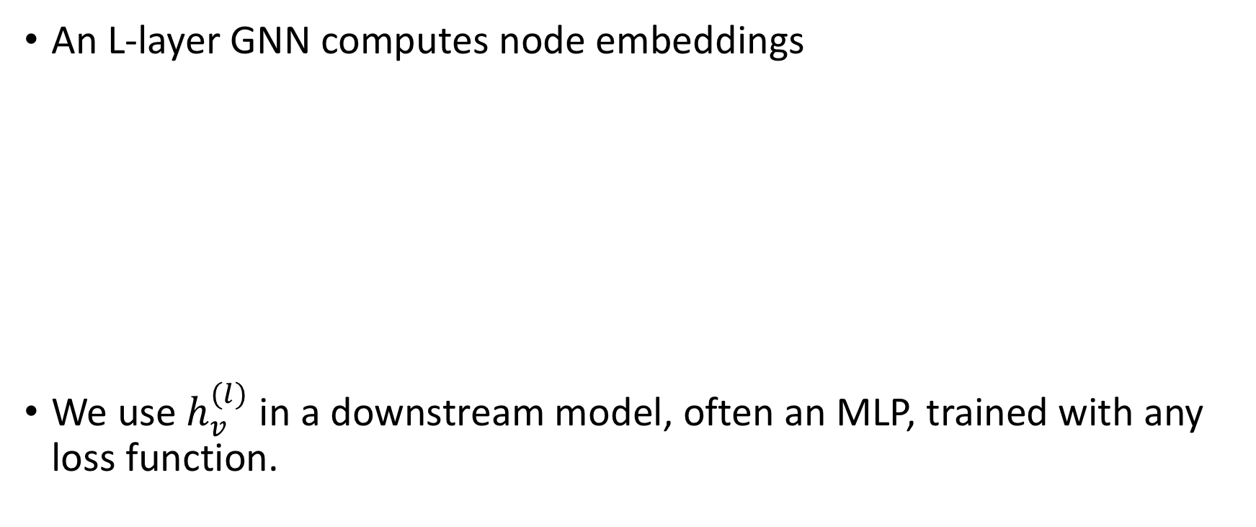
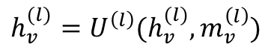
How to train an end-to-end GNN?
An L-layer GNN computes node embeddings
We use $h_{v}^{(l)}$ in a downstream model, often an MLP, trained with any loss function.
$$m_{v}^{(l)}=\sum_{w∈N(v)}{M^{\left(l\right)}(h_{v}^{\left(l−1\right)}, h_{w}^{\left(l−1\right)}, e_{vw})}$$
$$h_{v}^{(l)}=U^{\left(l\right)}(h_{v}^{(l)}, m_{v}^{\left(l\right)})$$

Slide 10
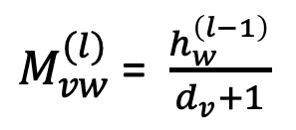
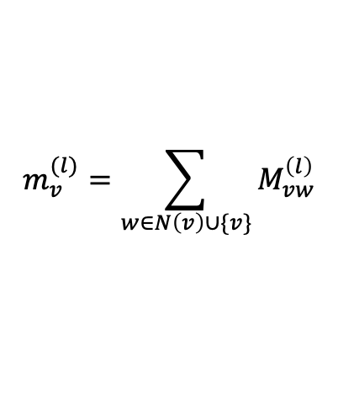
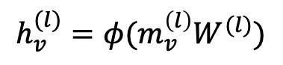
Example 1: Graph convolution network (GCN)
$M_{vw}^{(l)}$= $\frac{h_{w}^{\left(l−1\right)}}{d_{v}+1}$
$$m_{v}^{(l)}=\sum_{w∈N\left(v\right)∪\{v\}}{M_{vw}^{\left(l\right)}}$$
$$h_{v}^{(l)}=φ(m_{v}^{\left(l\right)}W^{(l)})$$

Slide 11
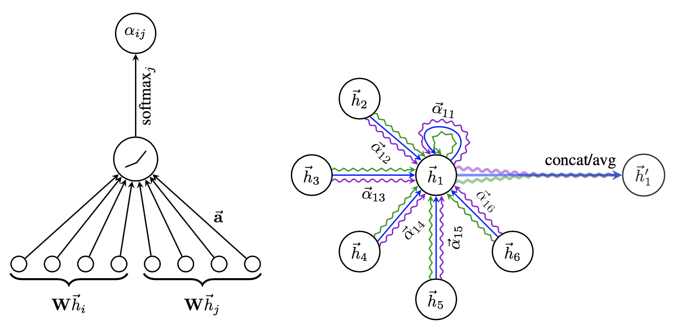
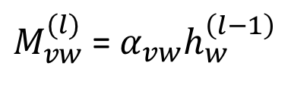
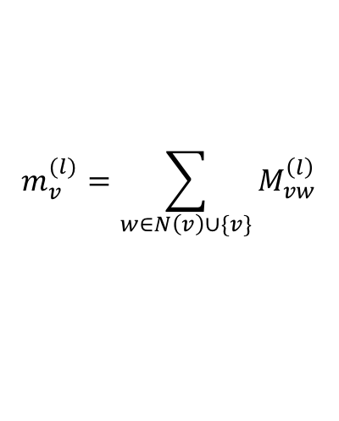
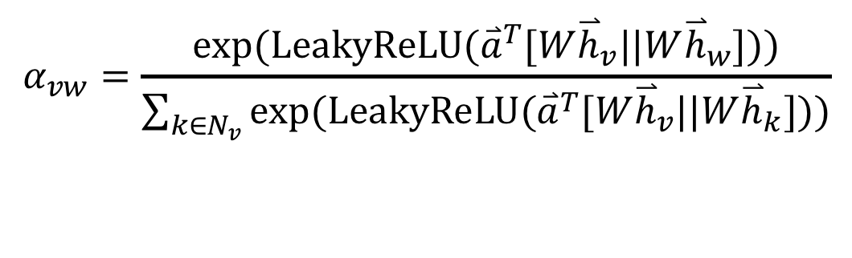
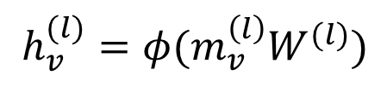
Example 2: Graph attention networks (GAT)
GAT provides weighted sum over the neighborhood—Enables to selectively integrate information.
$M_{vw}^{(l)}$= $α_{vw}h_{w}^{\left(l−1\right)}$
$$m_{v}^{(l)}=\sum_{w∈N\left(v\right)∪\{v\}}{M_{vw}^{\left(l\right)}}$$
$$h_{v}^{(l)}=φ(m_{v}^{\left(l\right)}W^{(l)})$$
$$α_{vw}=\frac{exp⁡(LeakyReLU({\overset{⃑}{a}}^{T}[W{\overset{⃑}{h}}_{v}||W{\overset{⃑}{h}}_{w}]))}{\sum_{k∈N_{v}}{exp⁡(LeakyReLU({\overset{⃑}{a}}^{T}[W{\overset{⃑}{h}}_{v}||W{\overset{⃑}{h}}_{k}]))}}$$

Slide 12
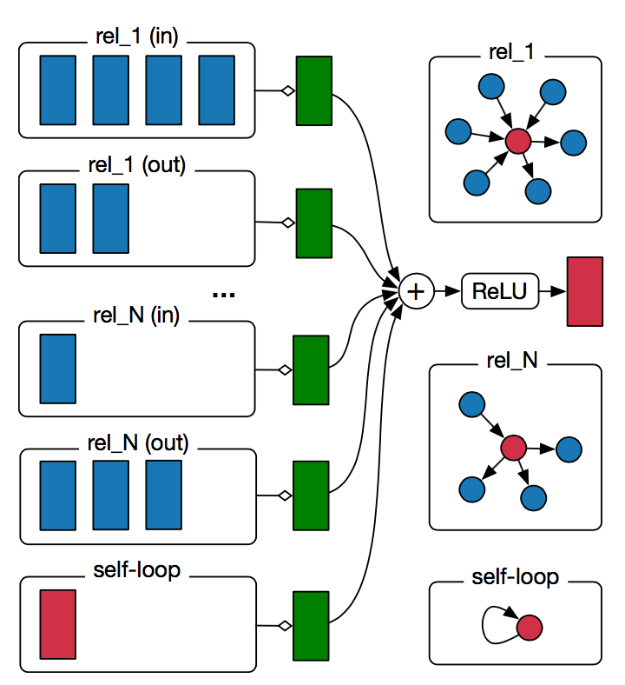
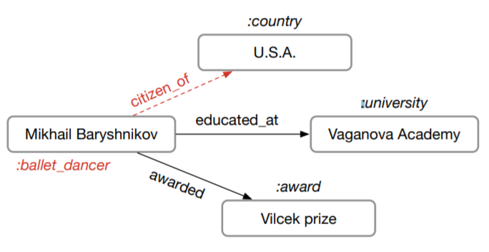
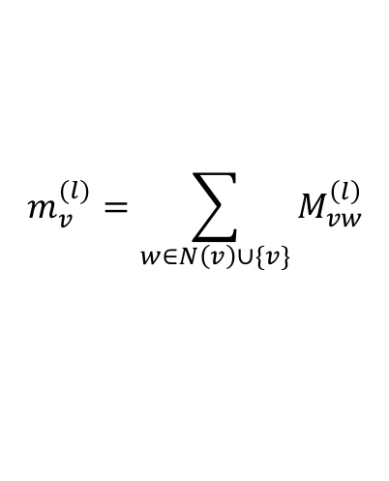
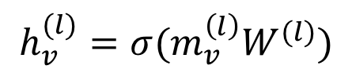
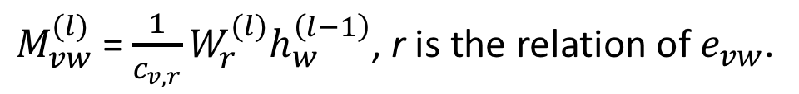
Example 3: Relational graph convolution networks (RGCN)
Handles graphs whose nodes are connected with different relations.
$M_{vw}^{(l)}$= $\frac{1}{c_{v,r}}W_{r}^{(l)}h_{w}^{\left(l−1\right)}$, r is the relation of $e_{vw}$.
$$m_{v}^{(l)}=\sum_{w∈N\left(v\right)∪\{v\}}{M_{vw}^{\left(l\right)}}$$
$$h_{v}^{(l)}=σ(m_{v}^{\left(l\right)}W^{(l)})$$
Notes:
In most real-world settings, the underlying graphs are heterogeneous
Define heterogeneous graphs
RGCN is a generalization of GCN to such graphs.

Slide 13
Deep Graph Library
A framework for developing and training GNN models

Slide 14
DGL: Deep Graph Library
V0.3.1
NN modules
DGL-LifeSci
V0.5
TF support
Distributed training
Memory/Computation-efficiency
Development started
V0.2
Sampling APIs
2018
2019
2020
Temporal graphs
More model zoos
More NN modules
Faster training
…
V0.3
Fused message passing
Multi-GPU/-core
First prototype
V0.1
(NeurIPS’18)
V0.4
Heterogeneous graph
DGL-KE

Slide 15
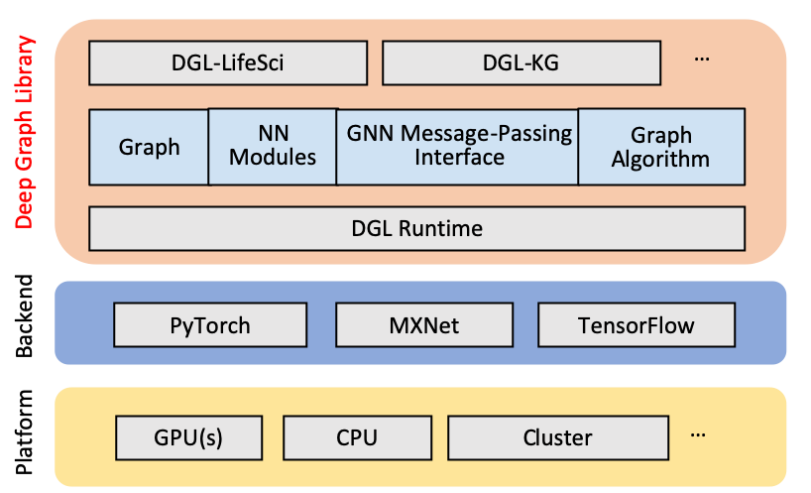
DGL’s architecture & meta-objective
Forward and backward compatible
Forward: easy to develop new models
Backward: seamless integration with existing frameworks
Fast and scalable

Slide 16

DGL Package: DGL-KE
https://github.com/awslabs/dgl-ke
An open-source package to efficiently compute knowledge graph embedding in various hardware:
Many-core CPU machine
Multi-GPU machine
A cluster of machines
DGL-KE support popular KGE models:
TransE, TransR
DistMult, ComplEx, RESCAL
RotatE
Applications: search, recommendation, question & answering

Slide 17
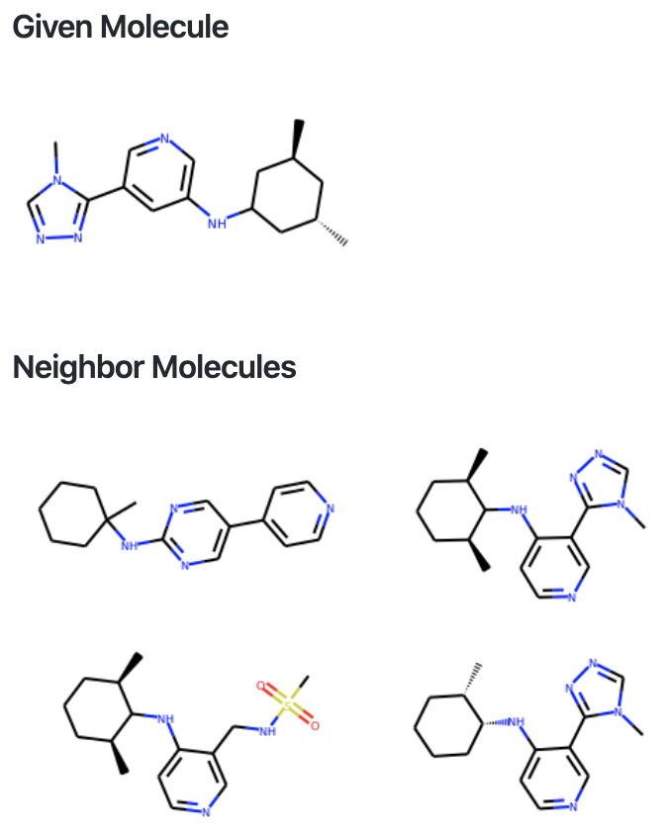
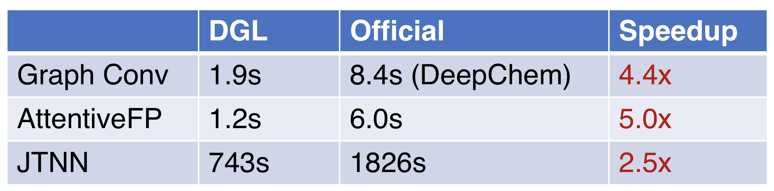
DGL Package: DGL-LifeSci
https://github.com/awslabs/dgl-lifesci
Pre-trained molecule generation models
Utilities for data processing
Models for molecular property prediction, molecule generation, reaction prediction
Graph Conv, GAT, MPNN, AttentiveFP, SchNet, MGCN, ACNN, DGMG, JTNN, WLN, etc.
Pre-trained models
Efficient implementations
Training scripts
Efficient implementations

Slide 18
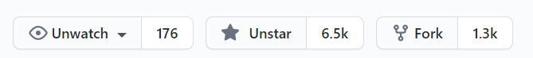
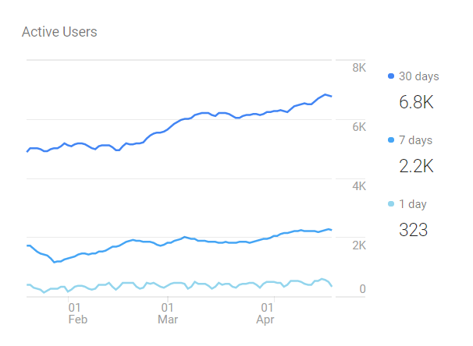
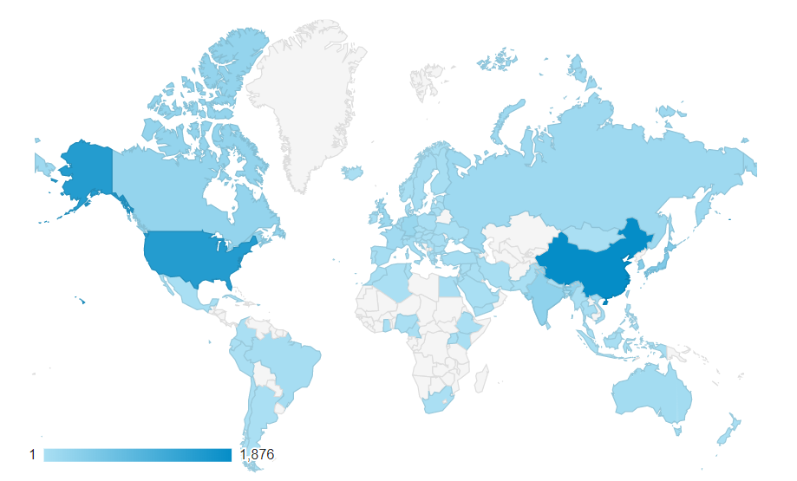
Open source, the source of innovation
6500 github stars 1770k downloads for all versions on Pip 13K downloads for all version on Conda 6.4K anaconda downloads of 0.4+ | 65 model examples, 31 NN modules (including 20 GNN convolution modules) 10 pretrained models for chemistry GCN, generative, KG, … 97 contributors, 10 core developers

Slide 19
DGL: design & API

Slide 20
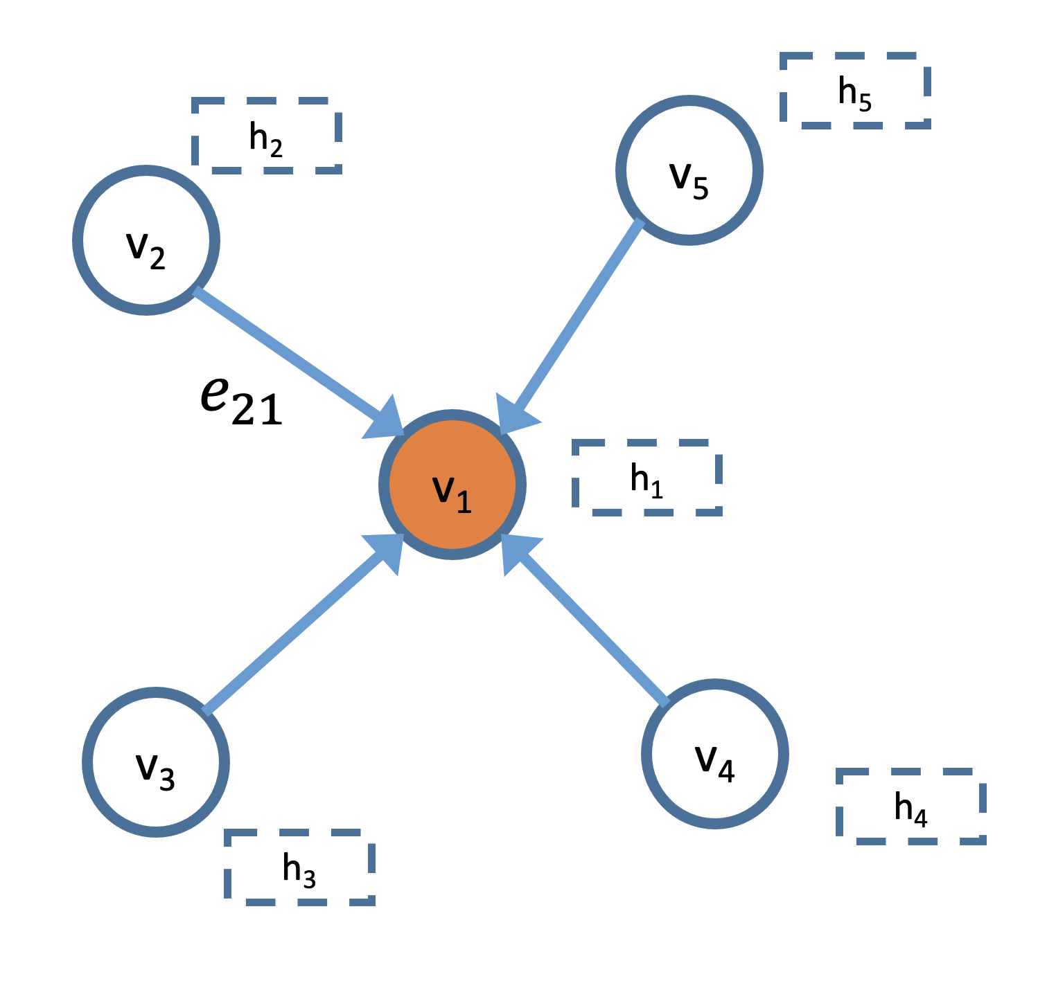
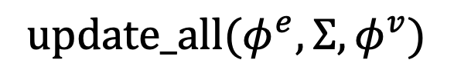
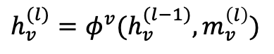
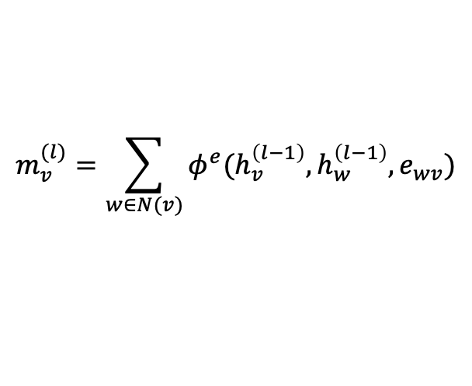
DGL programming interface
Graph as the core abstraction
DGLGraph
g.ndata[‘h’]
Simple but versatile message passing APIs
$$m_{v}^{(l)}=\sum_{w∈N(v)}{φ^{e}(h_{v}^{\left(l−1\right)}, h_{w}^{\left(l−1\right)}, e_{wv})}$$
$$update_all(φ^{e}, Σ, φ^{v})$$
$$h_{v}^{(l)}=φ^{v}(h_{v}^{(l−1)}, m_{v}^{\left(l\right)})$$
$φ^{e}$, $φ^{v}$, $Σ$ can be user-defined functions (UDFs) or built-in symbolic functions.

Slide 21
DGL’s API functionalities
Graph queries
Message passing API
Mini-batch generation
Distributed training (distributed graph, distributed tensors, etc)
nn modules for popular GNN models
Graph transformations
Multi-graph operations (e.g., batching and readout)
Graph datasets

Slide 22
Performance & Scalability

Slide 23
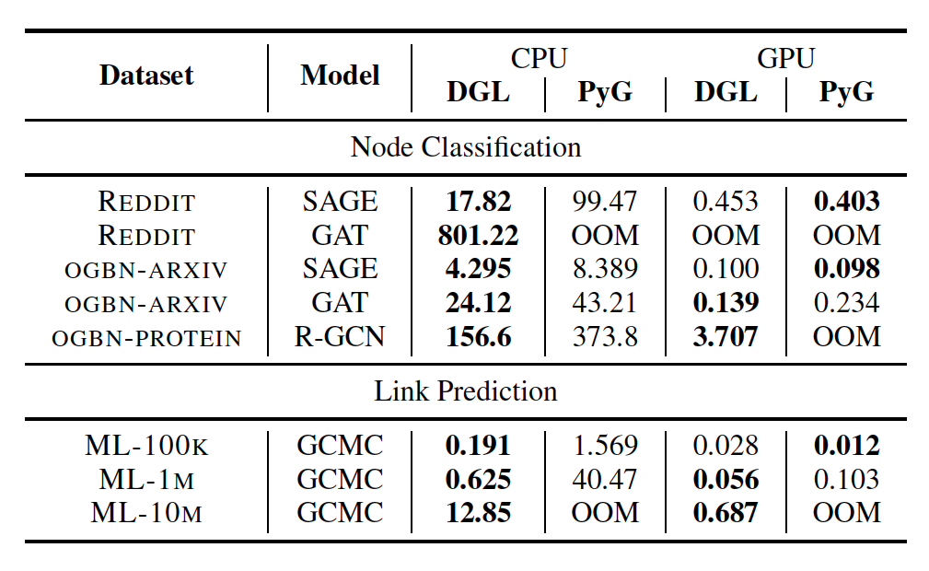
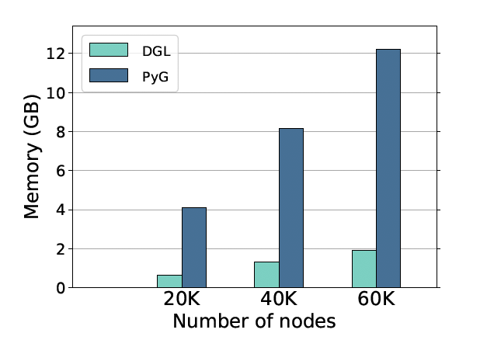
DGL: kernel performance
DGL is up to 1.8x faster on GPU and 64x faster on CPU
GAT on synthetic dataset
DGL uses 6.3x less memory
Paper available at: https://arxiv.org/abs/1909.01315

Slide 24
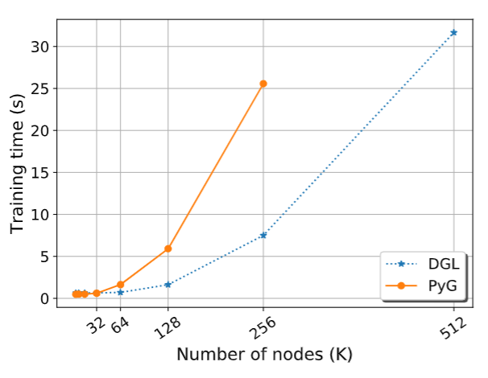
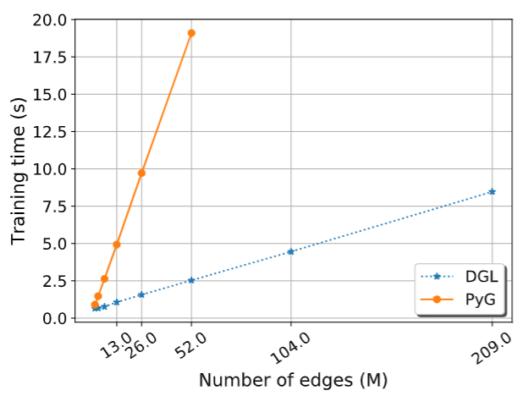
Scalability: single machine, single GPU
3.4x
7.5x
PyG: pytorch-geometric
Scalability with graph size
Scalability with graph density

Slide 25
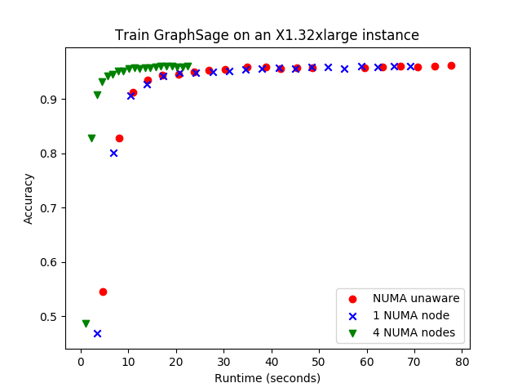
Scalability: single machine, NUMA
X1, 2TB, 128 vCPU
Data set: Reddit (232K nodes, 114M edges)
Controlled-variate sampling

Slide 26
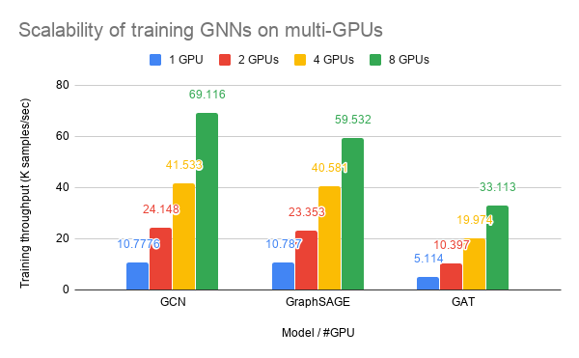
Scalability: single machine, multi-GPU
70%-80% parallel efficiency
p3.16xlarge, 8 V100 GPUs, 64 vCPU
Data set: Reddit (232K nodes, 114M edges)
Trained with neighbor sampling

Slide 27


Scalability: Distributed training
Scale to a graph with 110M nodes, 3.2B edges.
Linear speedup with almost no compromise in model accuracy.

Slide 28

Q&A
https://www.dgl.ai

Slide 29




Writing GNNs is intuitive in DGL
Notes:
These slides need to be made consistent with the update_all() definition.

Slide 30



Writing GNNs is intuitive in DGL (GAT)

Slide 31




Different scenarios require different support
Sampling
Batching graphs
Single giant graph
Many moderate-sized graphs
Mutation
Heterogeneous
Dynamic graph
Heterogeneous graph
Notes:
Another design consideration is that graphs in different scenarios require different supports
Community detection: system needs to be memory efficient, and support random walk and graph sampling
Drug discovery, protein property prediction: batching is a high priority
The system should support graph mutation
For example, this graph here represents the interactions in a search engine. A task could be given a query, what is the page returned? This can be casted as a link prediction problem on this graph.

